Slide 1

Course Code & Module : MIT 4201 - Software Quality Assurance
Course Lecturer : Senior Lecture Mr. R M U A Rathnayake
Assignment : Assignment 2 TestNG - Selenium
Student Name : Kumarage Navindu Madusanka Dias (K.N.M.Dias)
Index No : 22550119
Registration No : 2022/MIT/011
GitHub Public Repository Link :
https://github.com/NavinduMadusanka/Assignment2-TestNG-Selenium-IndexNo.22550119-MIT4201SoftwareQualityAssurance.git

Slide 2
Table of Contents
Page No.
1. Project Setup and Configuration………………………………………..6
Maven Project Structure………………………………………...6
Dependencies Configuration (pom.xml)………………………..7
Environment Configuration Files……………………………….8
WebDriver Setup Configuration………………………………...9
2. Framework Architecture………………………………………………..10
Base Classes Implementation…………………………………..10
Utility Classes…………………………………………………..11
Constants and Configuration Management…………………….12
Test Data Management Structure………………………………13
Page Object Model Implementation…………………………....14

Slide 3
Table of Contents
Page No.
3. Page Objects Layer Base Page Class…………………………………...15
Main Page Test Case Ebay……………………………………..15
Main Test Cases Pages Ebay…………………………………...16
Sub Pages Test Cases Ebay…………………………………….17
Utils…………………………………………………………….18
4. Test Layer………………………………………………………………..19
Base Test Class………………………………………………...19
Test Suites Organization……………………………………….20
Data-Driven Tests Implementation…………………………….21
Parallel Execution Setup……………………………………….22

Slide 4
Table of Contents
Page No.
5. Test Data Management………………………………………………….23
Excel Data Source Implementation…………………………….23
TestNG Data Provider Classes…………………………………24
Test Data Configuration Files………………………………….25
Data Validation Utilities………………………………………..26
6. Reporting and Logging………………………………………………….27
Extent Reports Configuration………………………………….27
TestNG Reports Customization………………………………..28
Screenshot Capture Mechanism……………………………….29
Allure Reports…….……..…………………………………….30

Slide 5
Table of Contents
Page No.
7. Utility Components………………………………………………………31
Driver and IDE Actions……..…………………….…………....31
Common JavaScript Utilities…………………………………...32
Wait Strategies Implementation………………………………...33
Excel File Handling Utilities…………………………………...34
8. CI/CD Integration……………………………………………………….35
Jenkins Pipeline Configuration………………………………...35
Test Execution Scripts…………………………………………36
Headless Browser Setup……………………………………….37
Build and Deployment Scripts………………………………....38

Slide 6
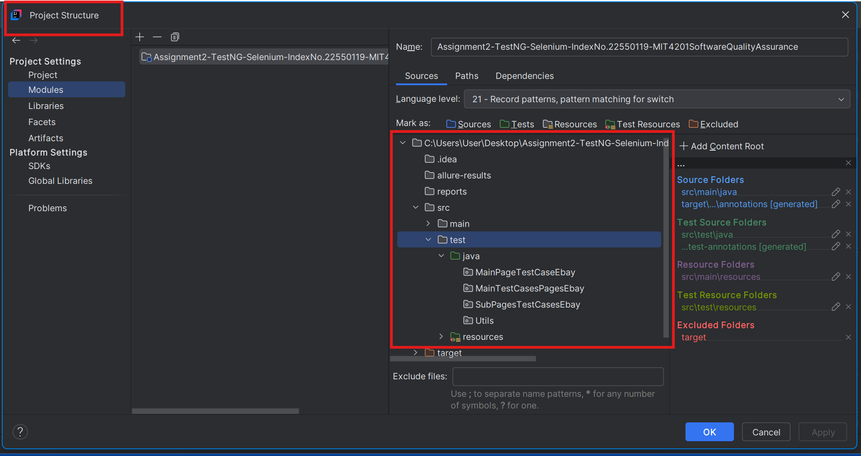
1. Project Setup and Configuration - Maven Project Structure

Slide 7
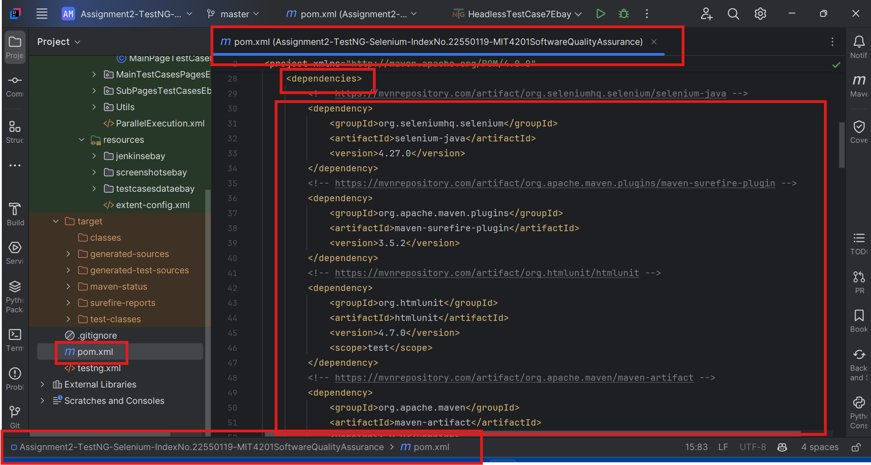
1. Project Setup and Configuration - Dependencies Configuration (pom.xml)

Slide 8
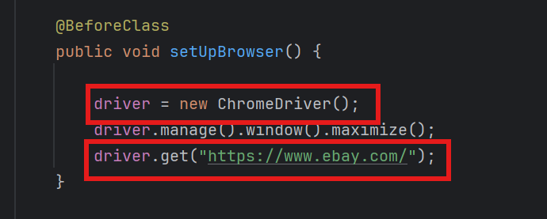
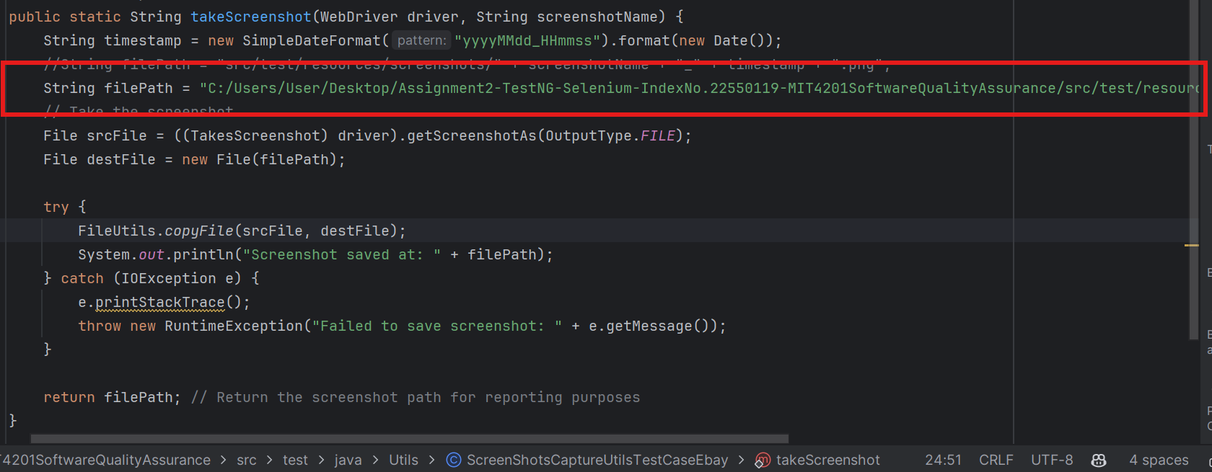
1. Project Setup and Configuration - Environment Configuration Files

Slide 9
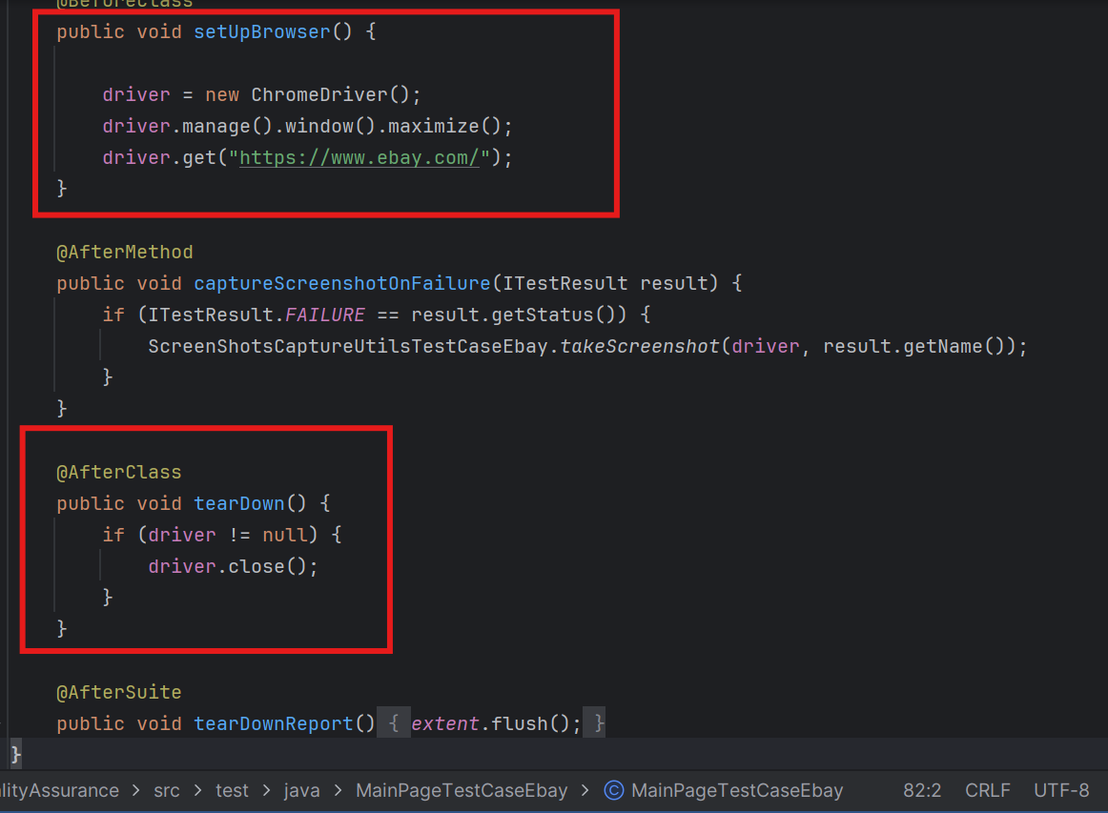
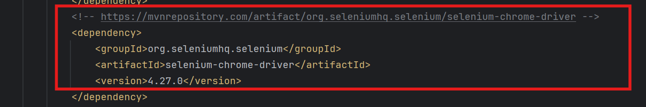
1. Project Setup and Configuration - WebDriver Setup Configuration

Slide 10
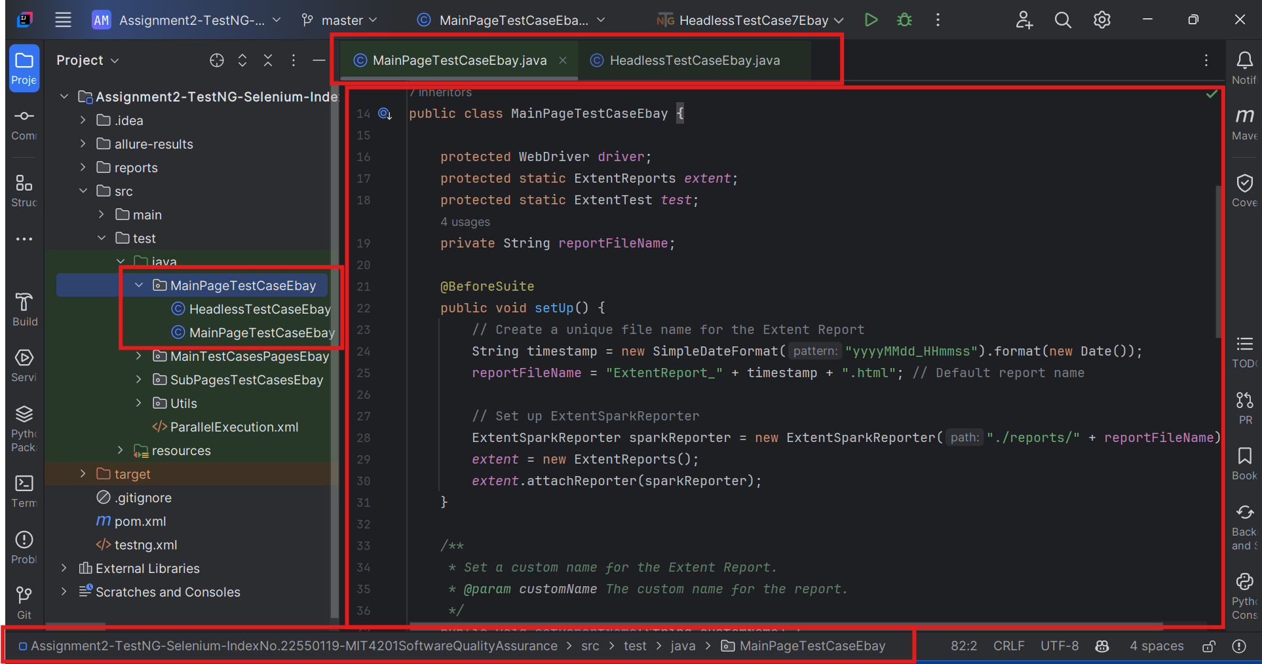
2. Framework Architecture - Base Classes Implementation

Slide 11
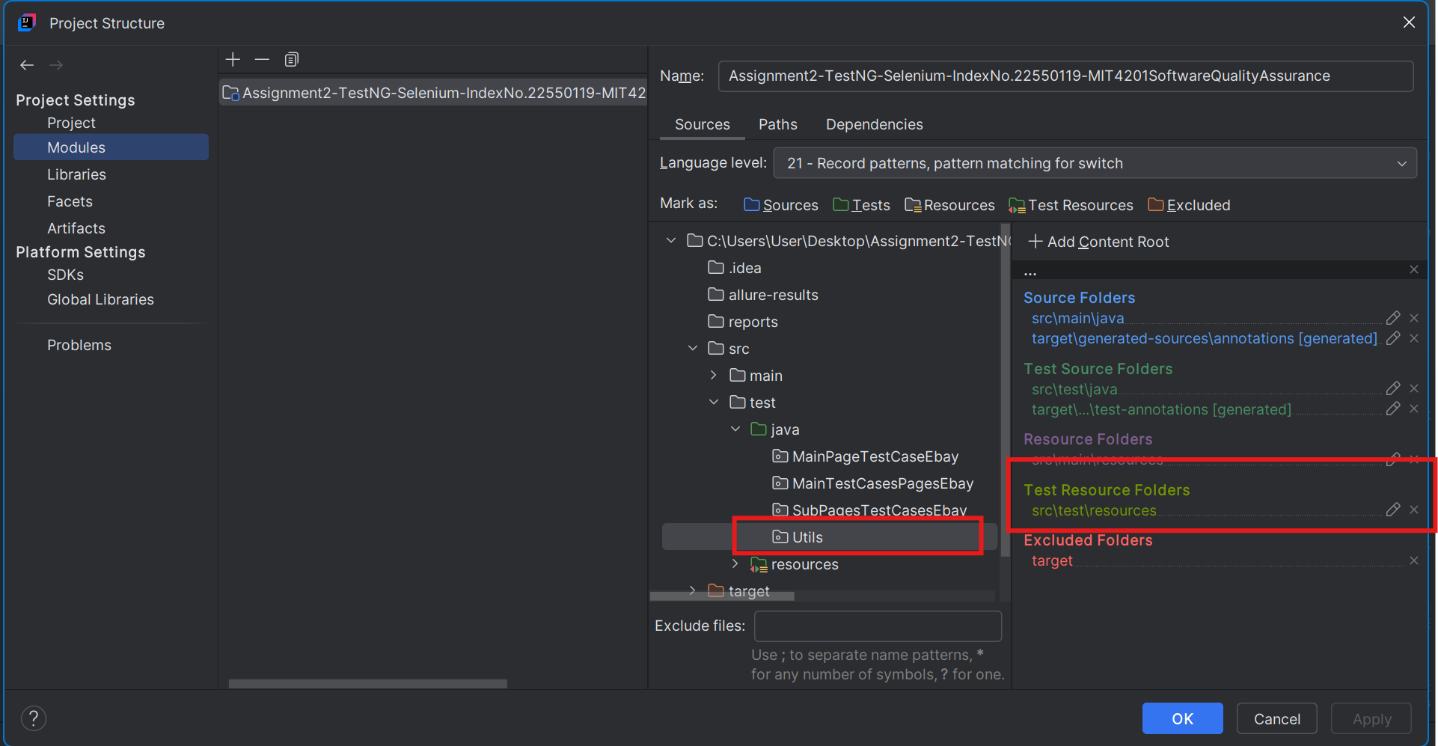
2. Framework Architecture - Utility Classes

Slide 12
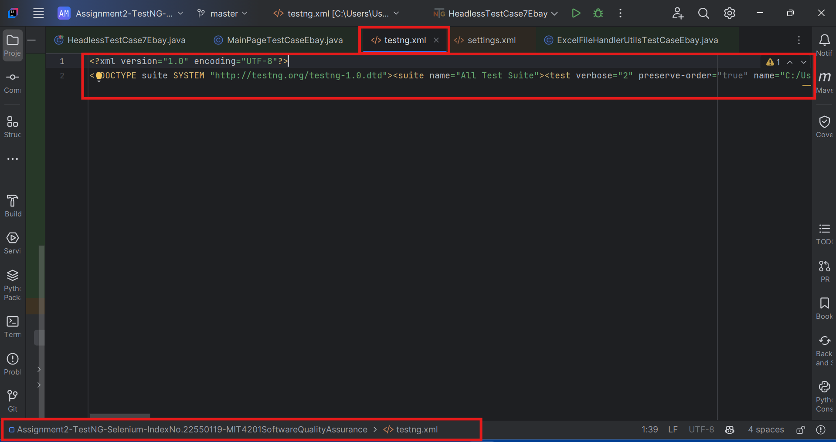
2. Framework Architecture - Constants and Configuration Management

Slide 13
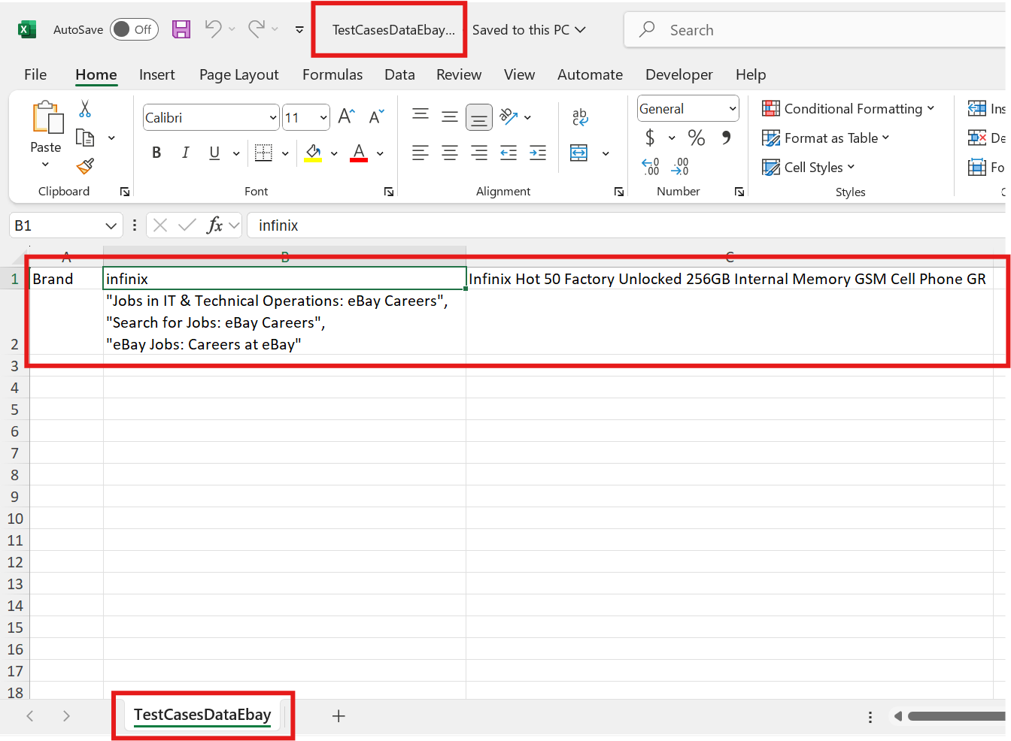
2. Framework Architecture - Test Data Management Structure

Slide 14
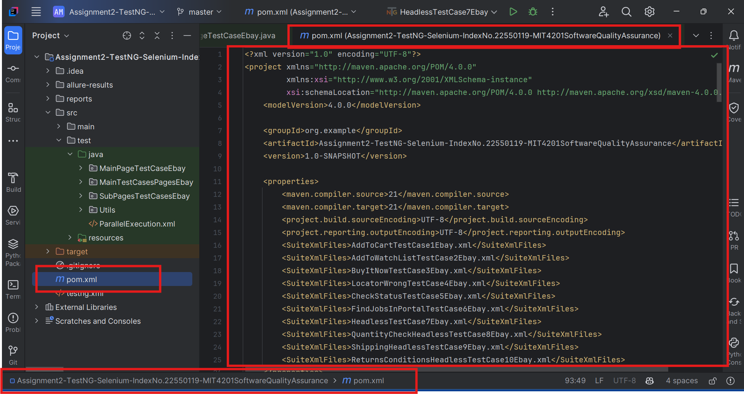
2. Framework Architecture - Page Object Model Implementation

Slide 15
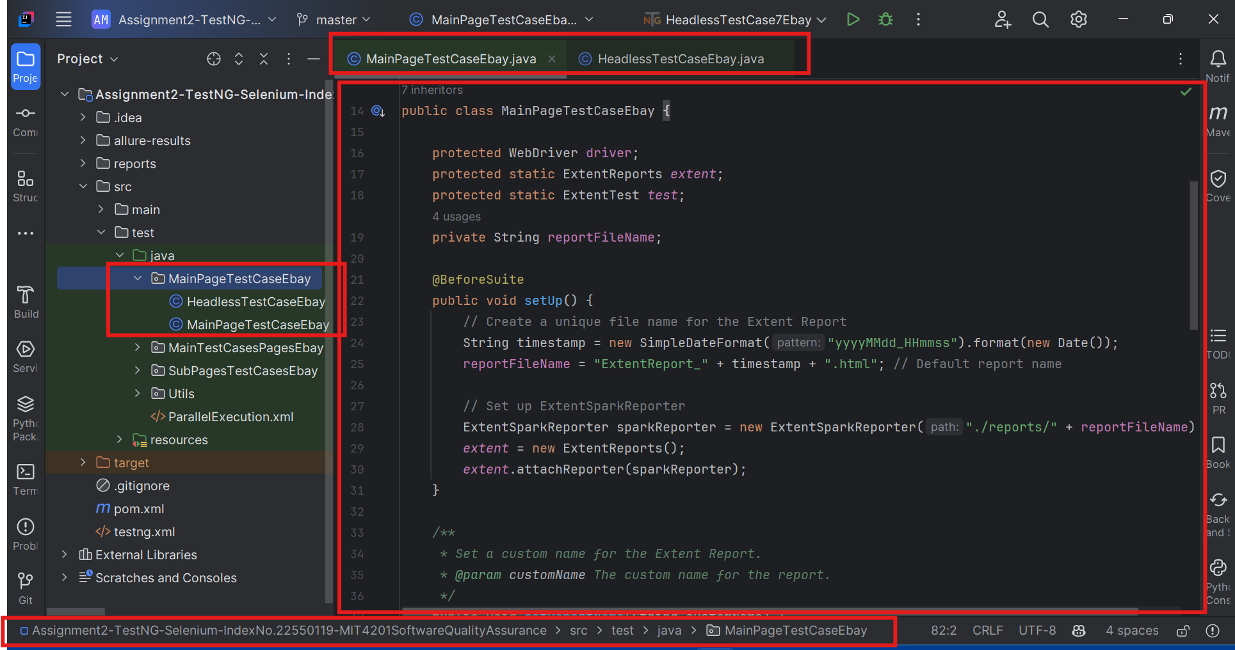
3. Page Objects Layer Base Page Class - Main Page Test Case Ebay

Slide 16
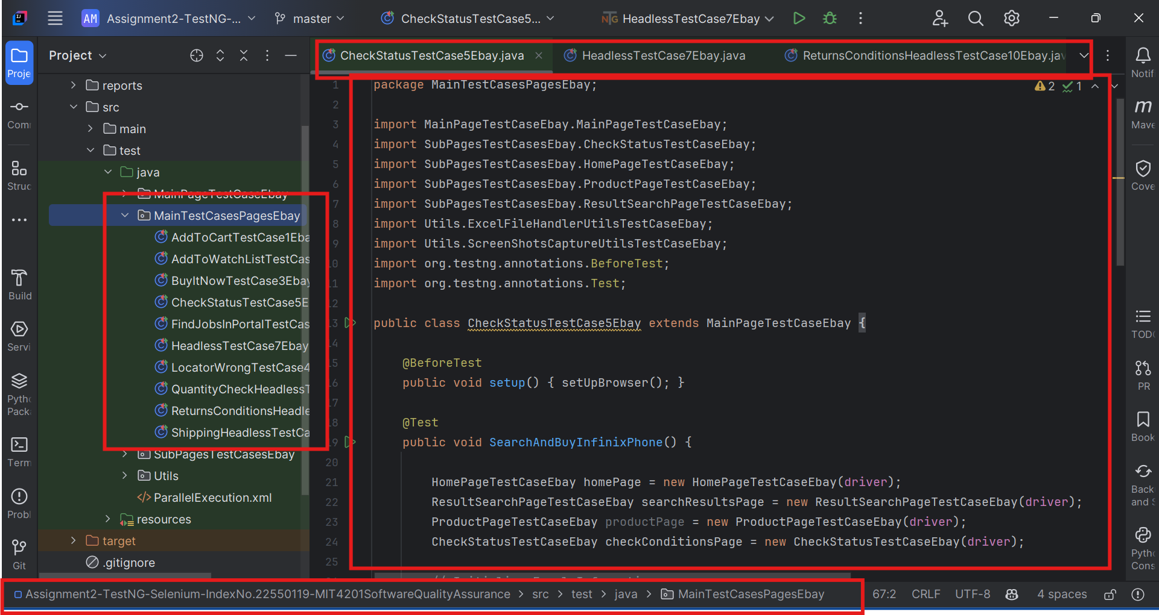
3. Page Objects Layer Base Page Class - Main Test Cases Pages Ebay

Slide 17
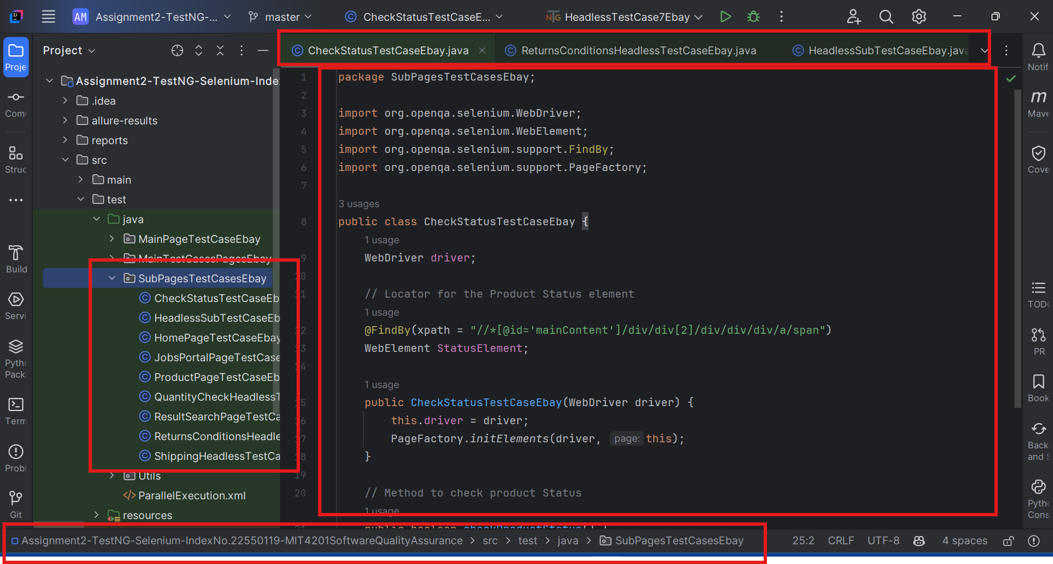
3. Page Objects Layer Base Page Class - Sub Pages Test Cases Ebay

Slide 18
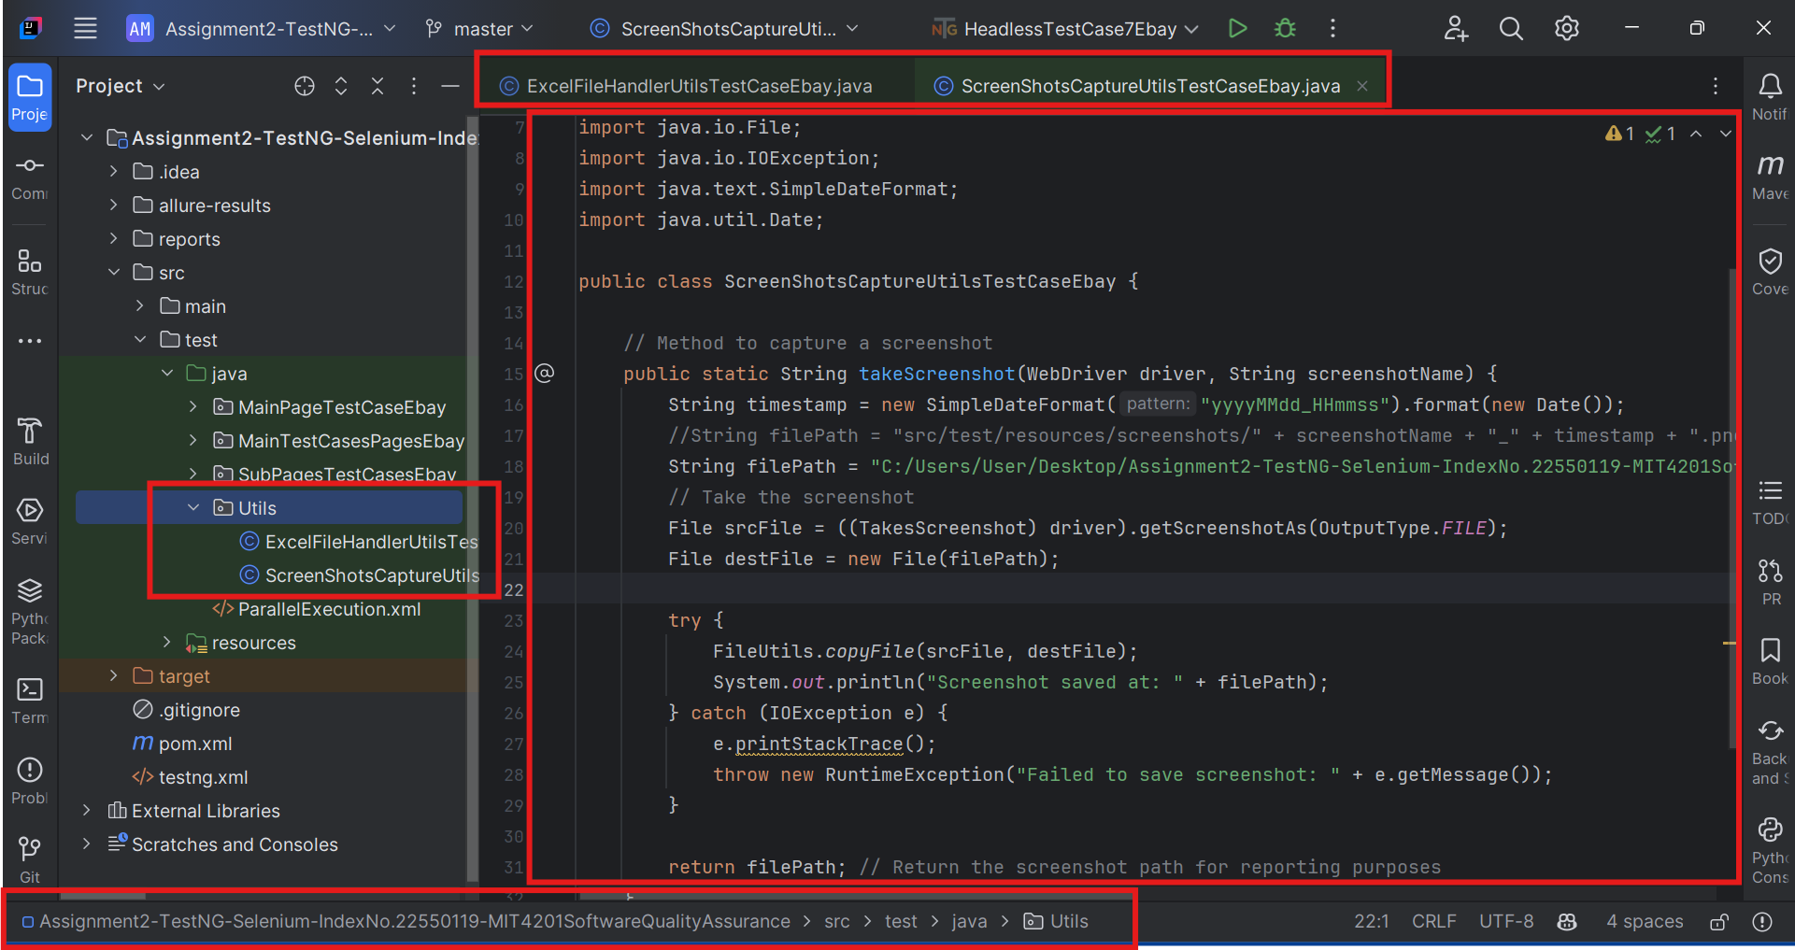
3. Page Objects Layer Base Page Class - Utils

Slide 19
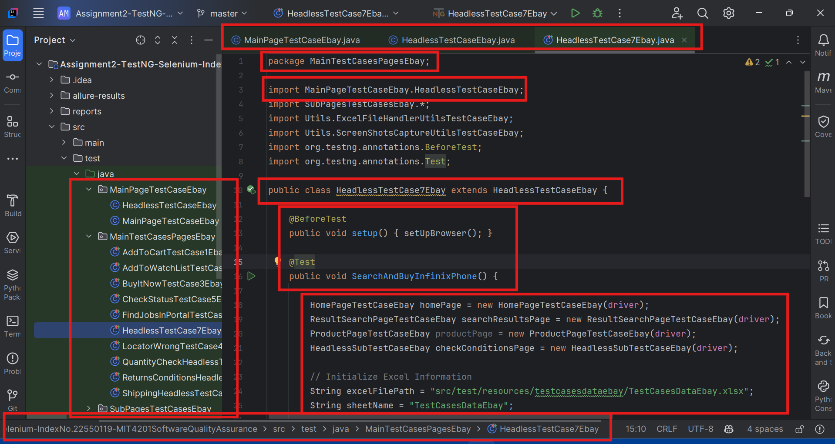
4. Test Layer - Base Test Class

Slide 20
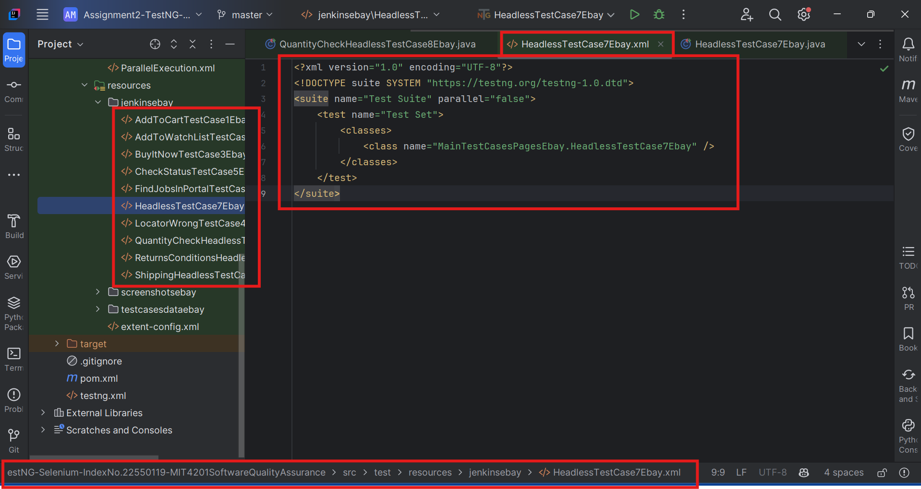
4. Test Layer - Test Suites Organization

Slide 21
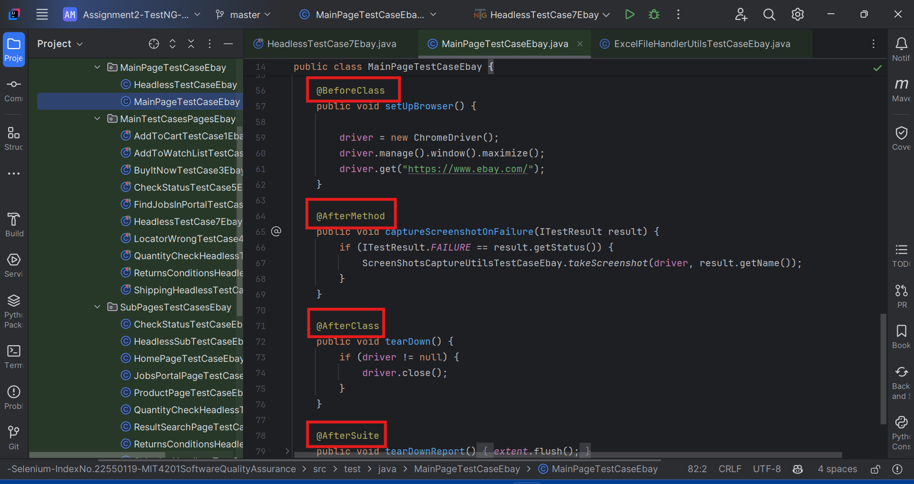
4. Test Layer - Data-Driven Tests Implementation

Slide 22
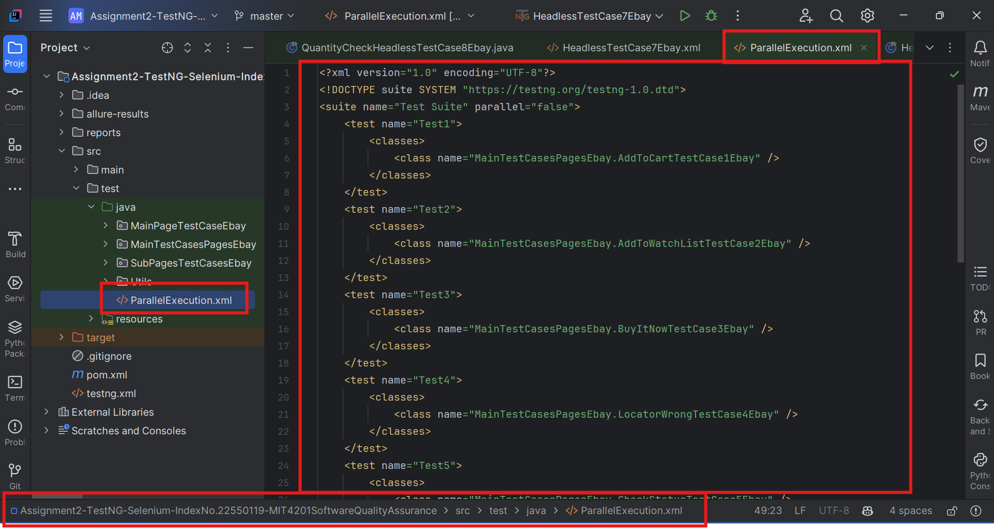
4. Test Layer - Parallel Execution Setup

Slide 23
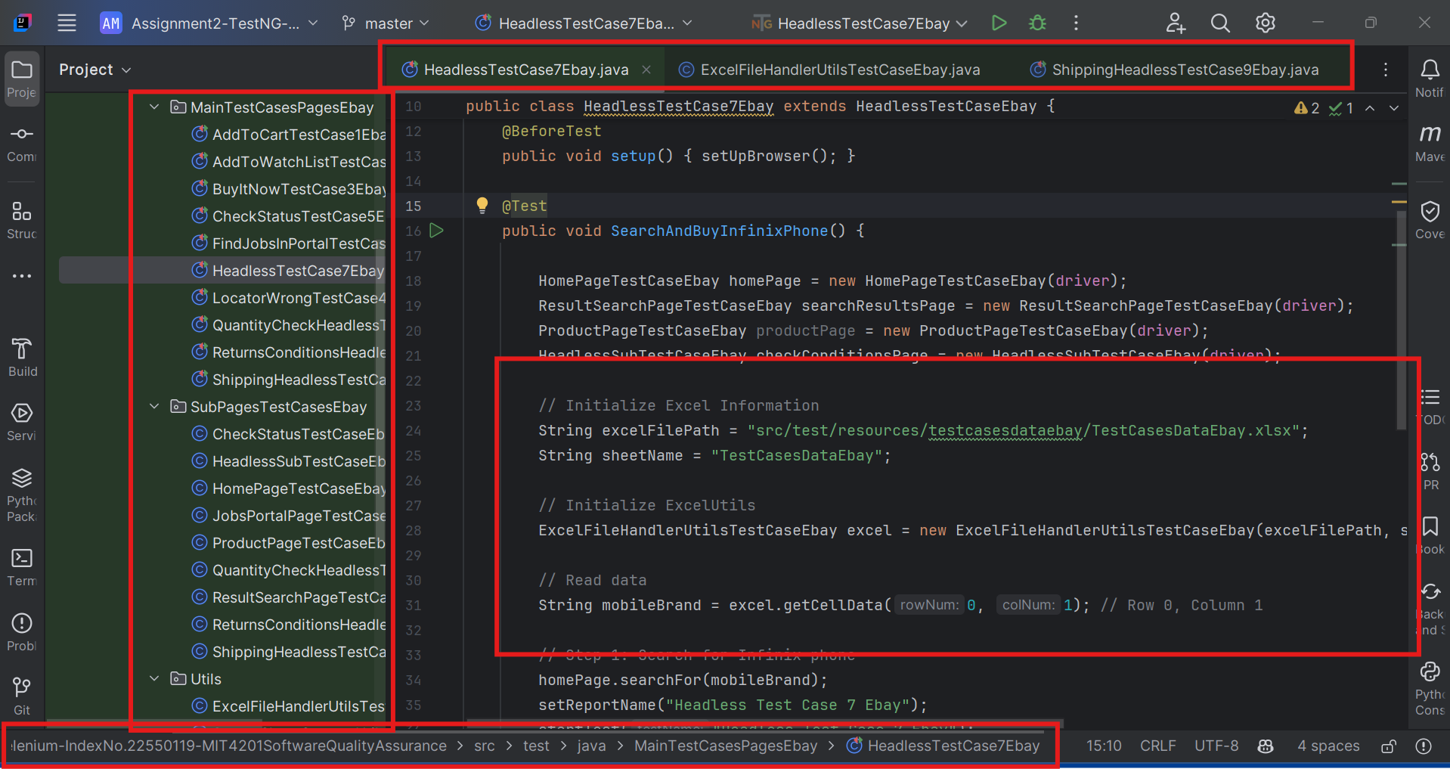
5. Test Data Management - Excel Data Source Implementation

Slide 24
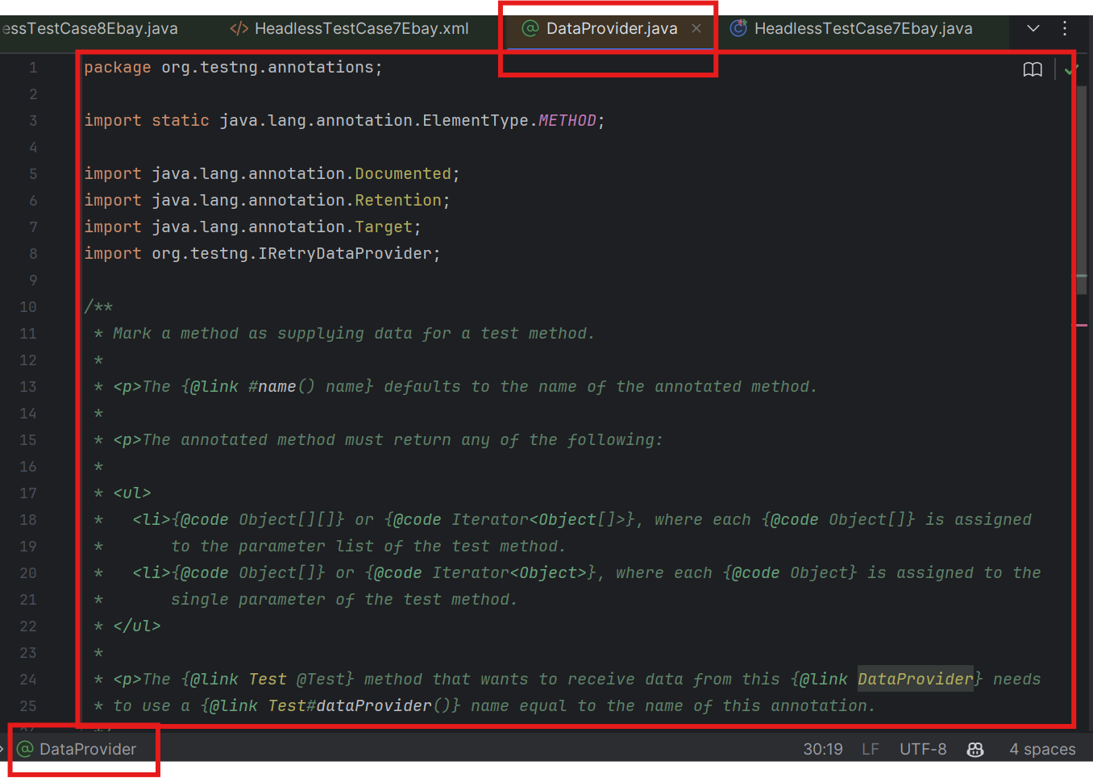
5. Test Data Management - TestNG Data Provider Classes

Slide 25
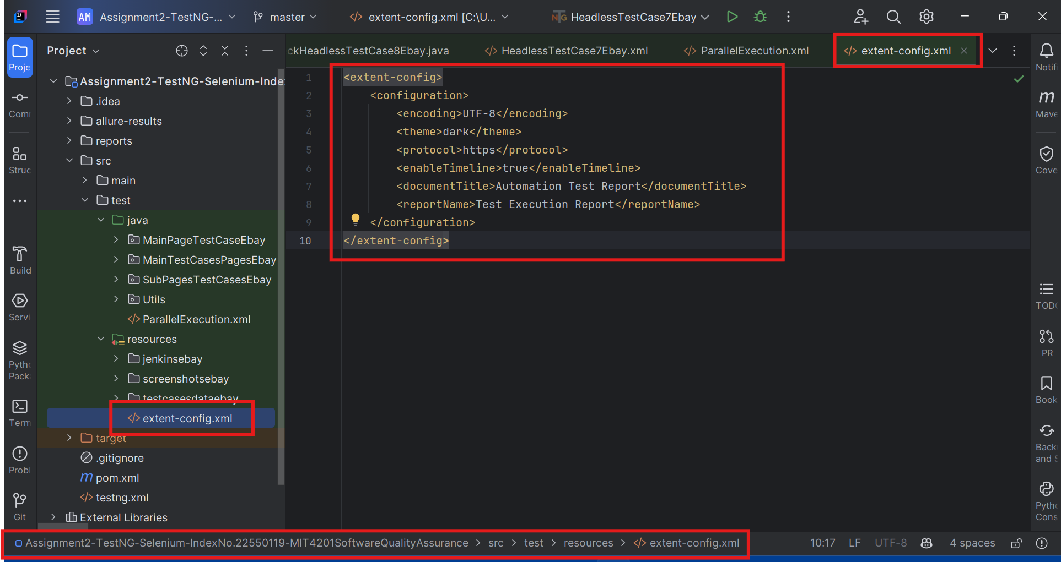
5. Test Data Management - Test Data Configuration Files

Slide 26
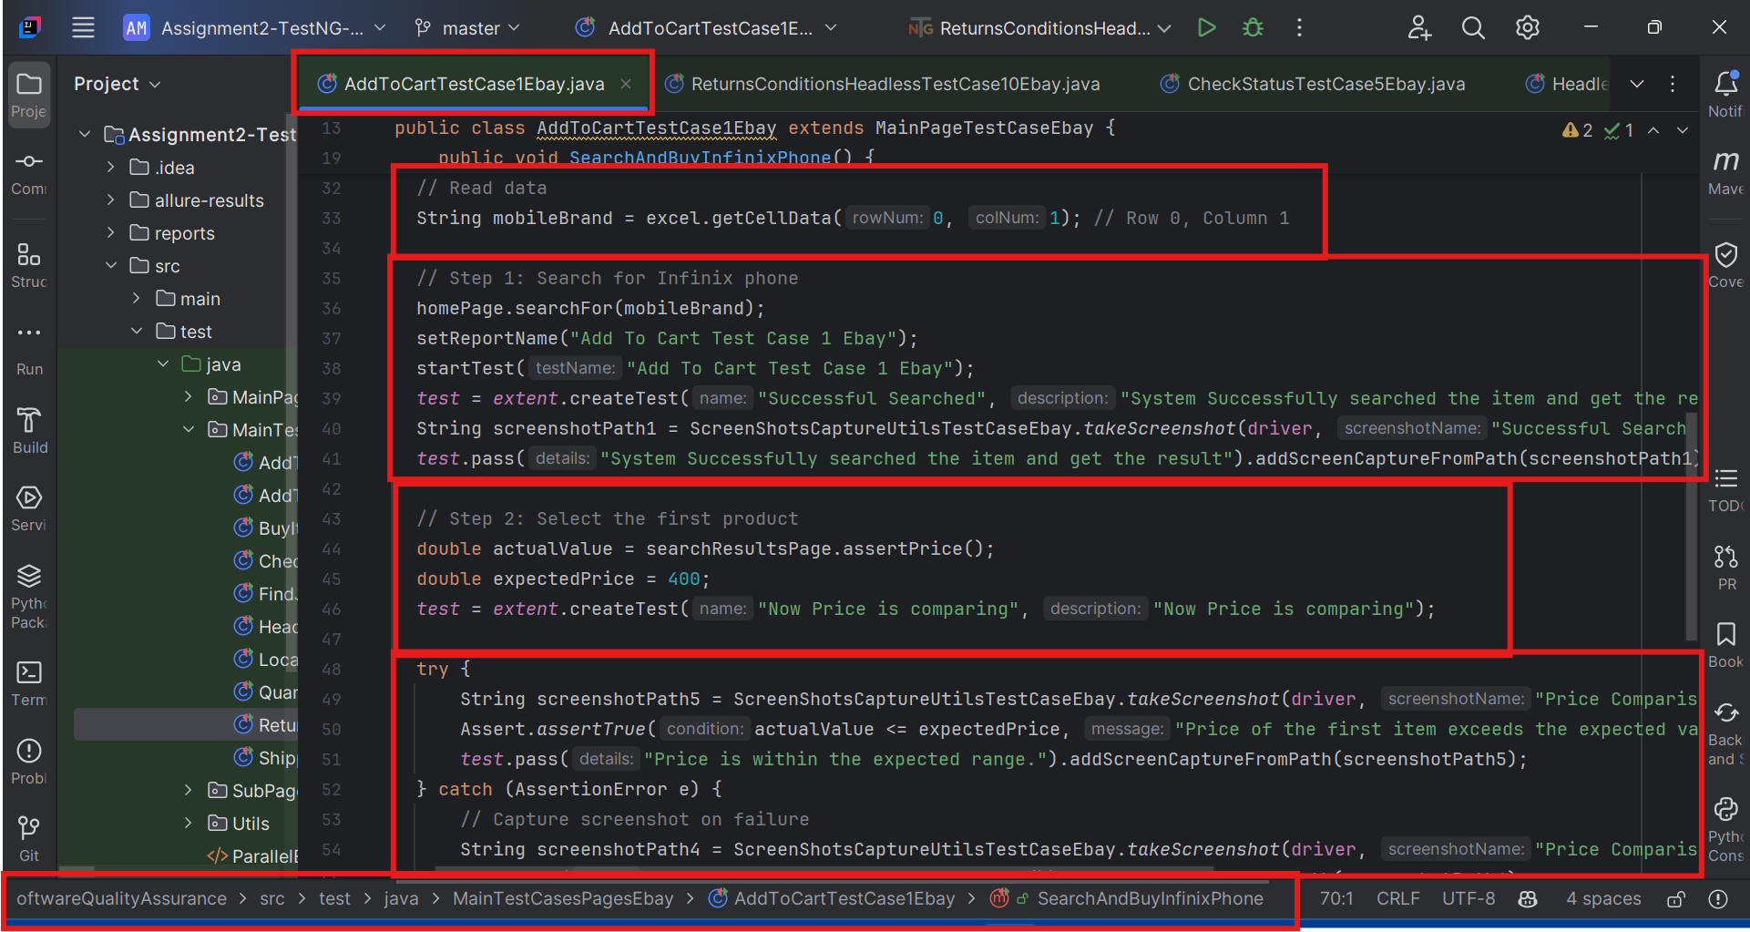
5. Test Data Management - Data Validation Utilities

Slide 27
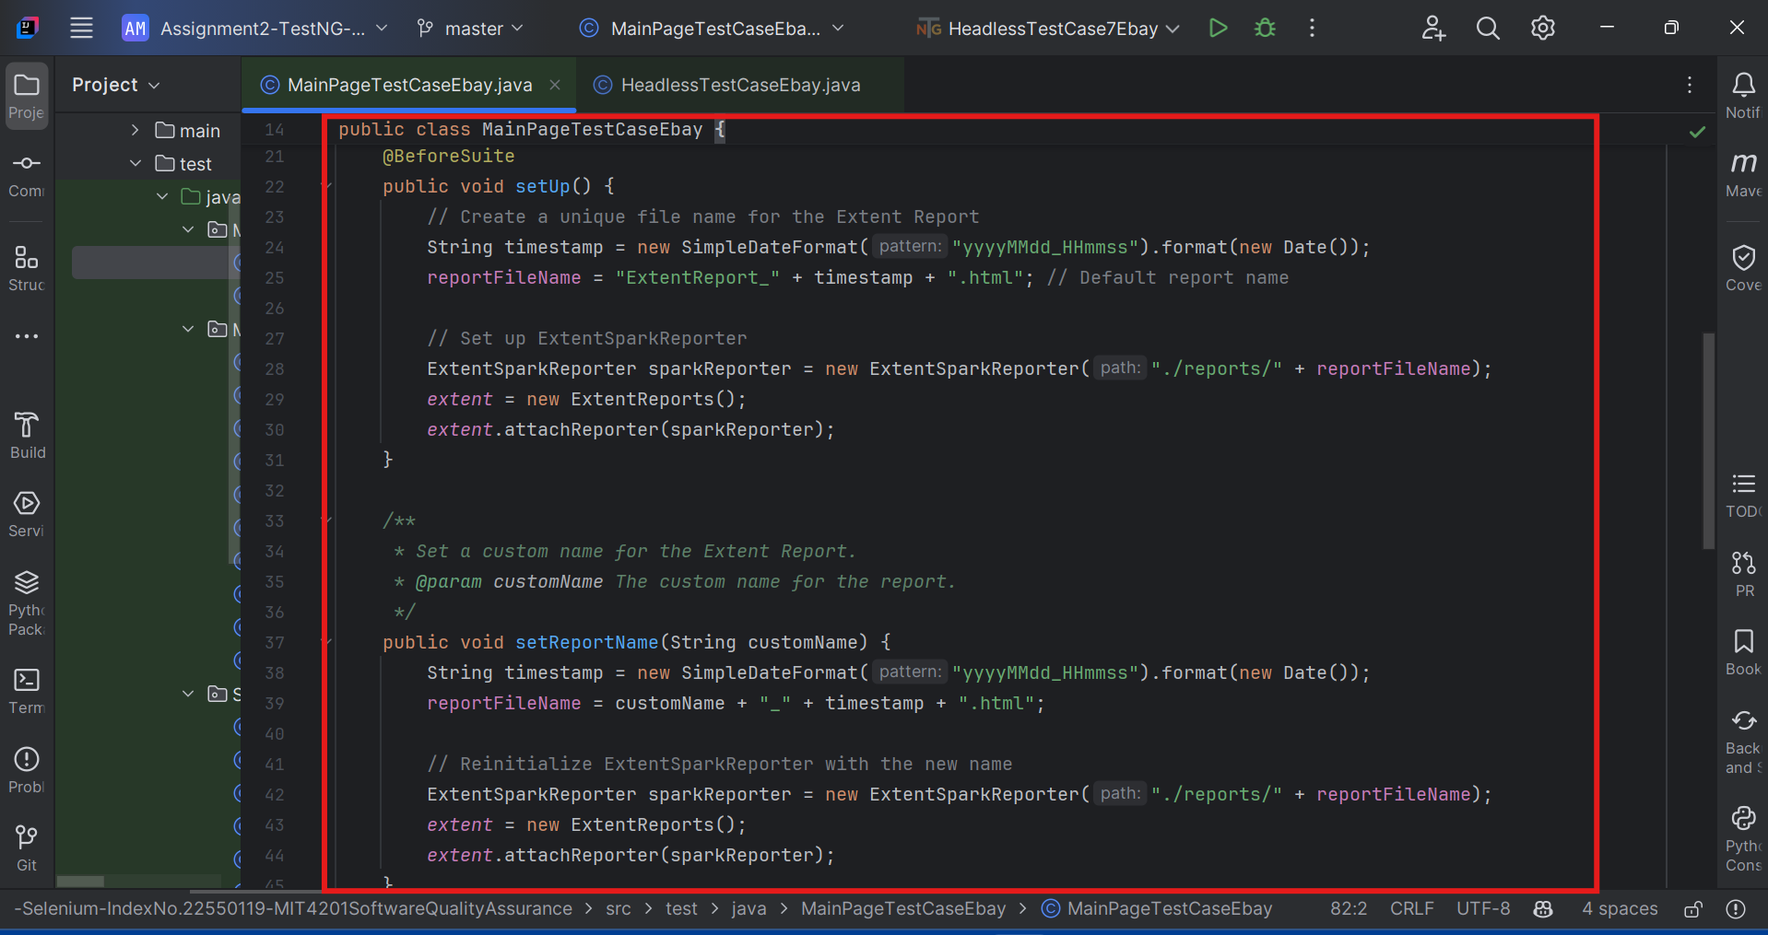
6. Reporting and Logging - Extent Reports Configuration

Slide 28
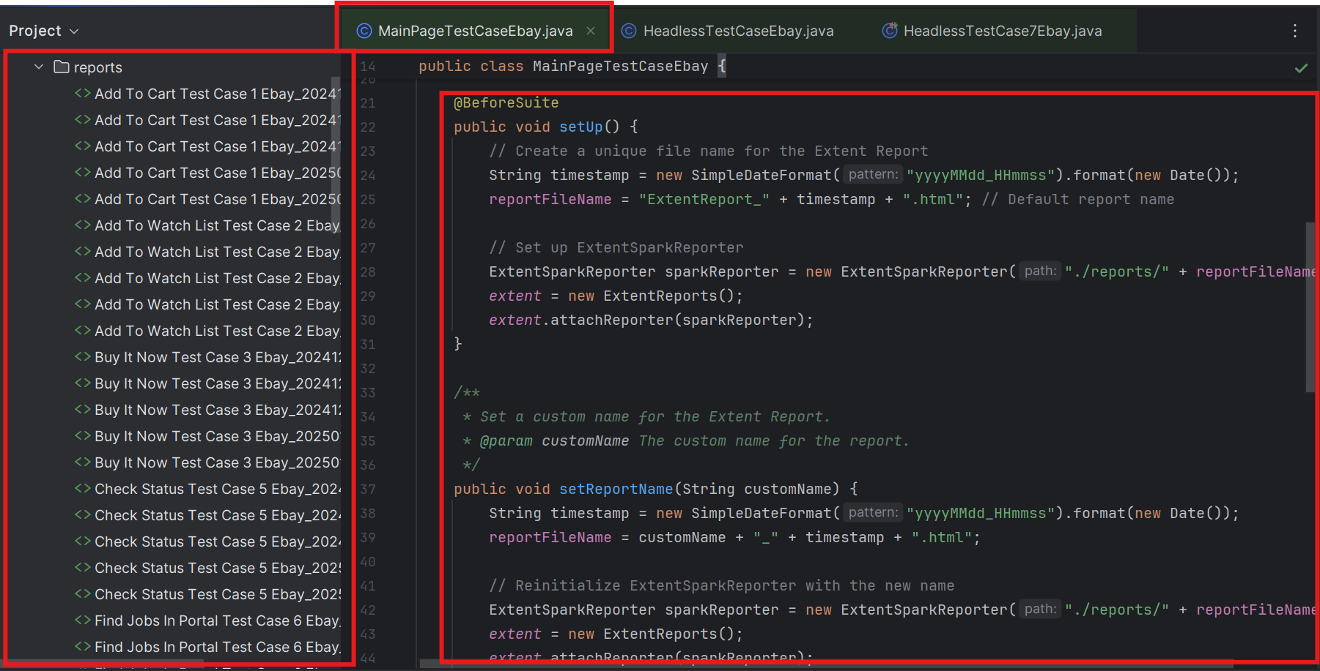
6. Reporting and Logging - TestNG Reports Customization

Slide 29
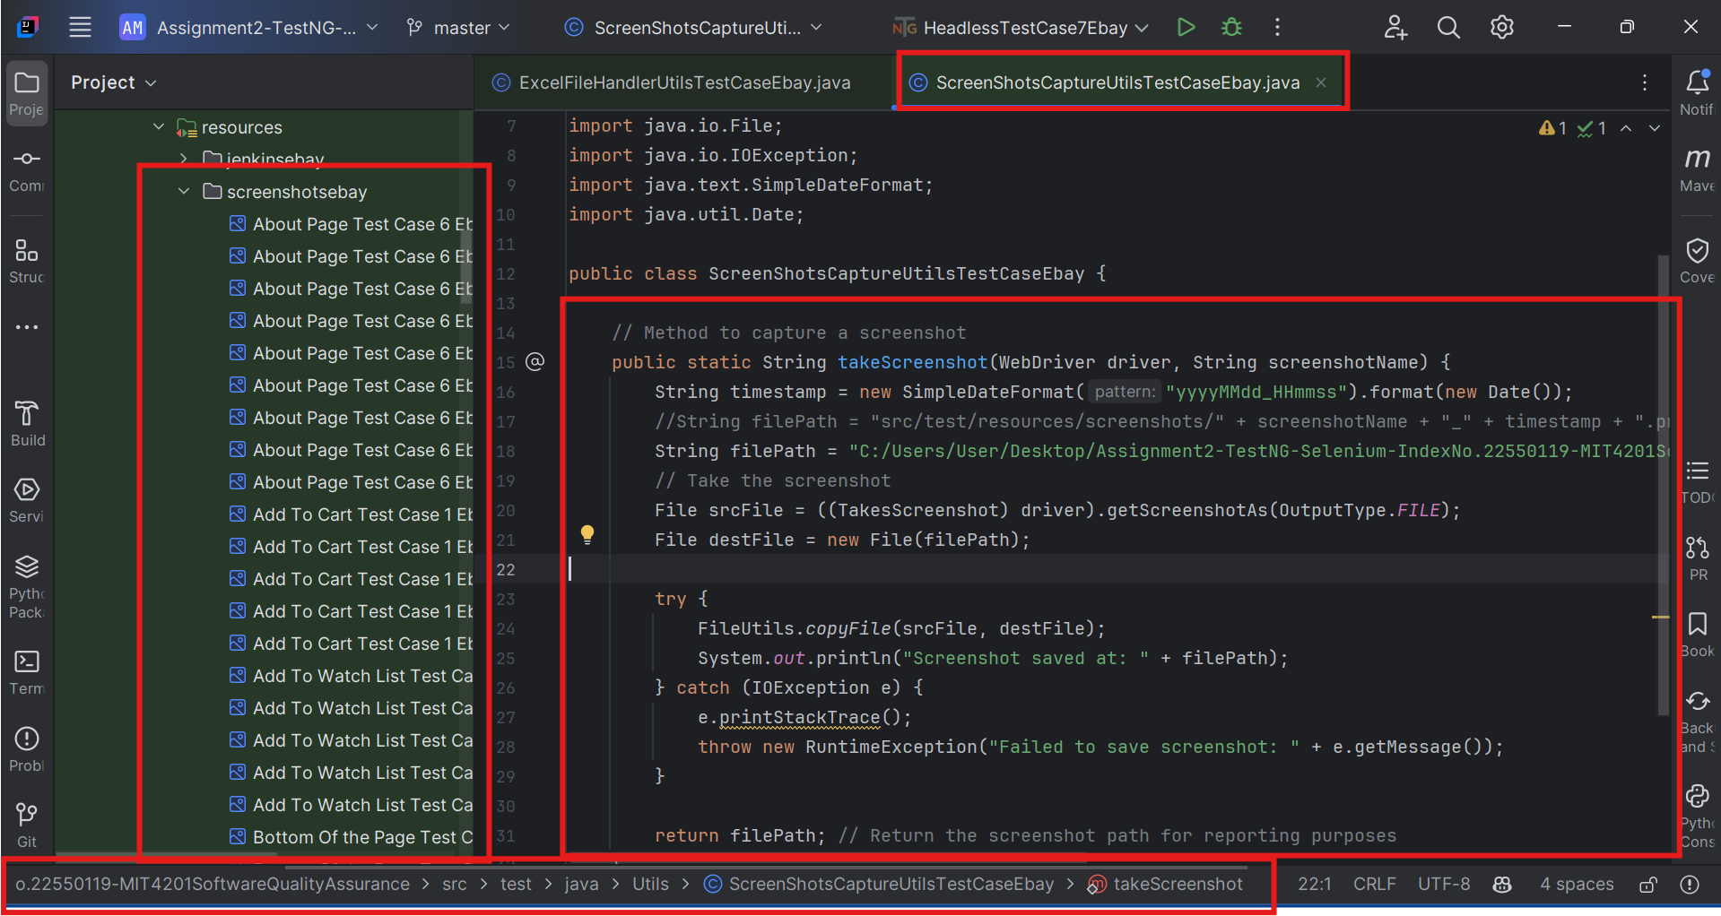
6. Reporting and Logging - Screenshot Capture Mechanism

Slide 30
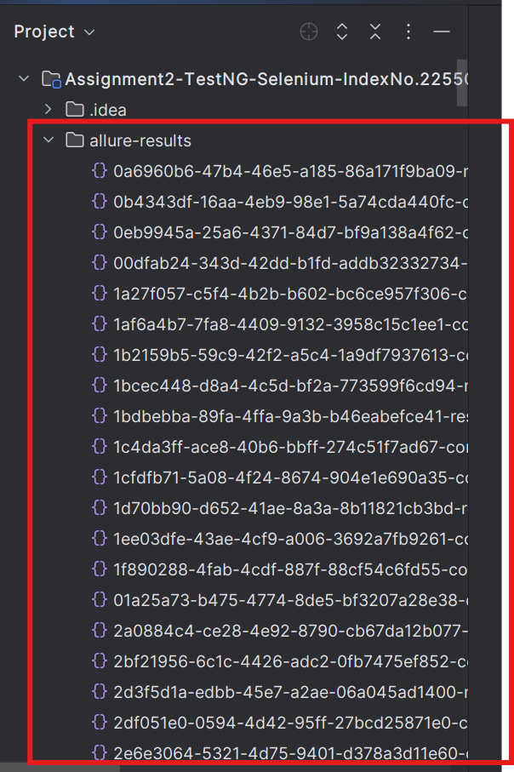
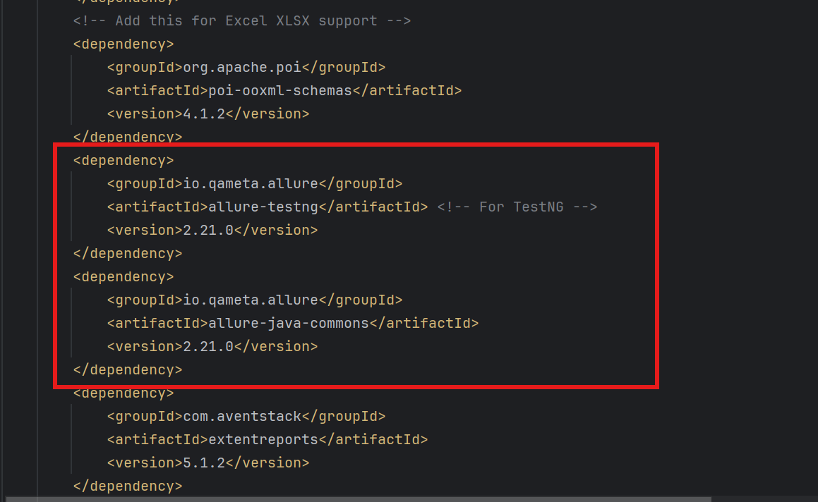
6. Reporting and Logging - Allure Reports

Slide 31
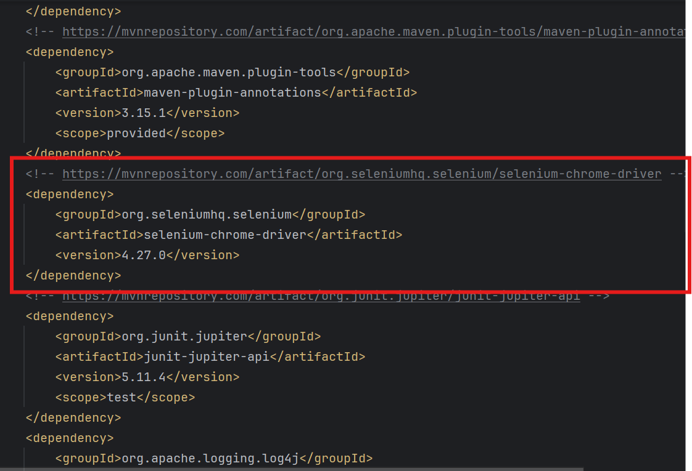
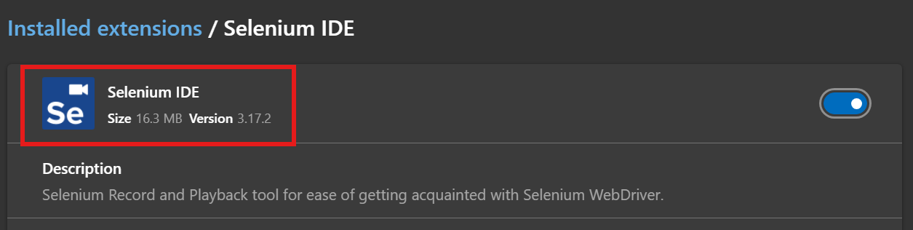
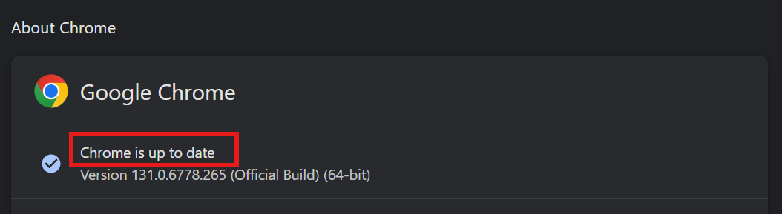
7. Utility Components – Driver and IDE Actions

Slide 32
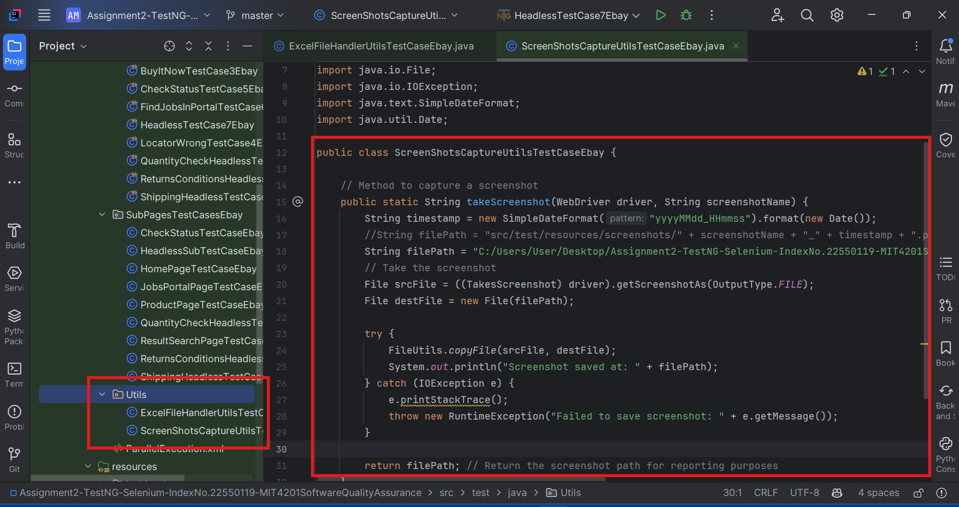
7. Utility Components - Common JavaScript Utilities

Slide 33
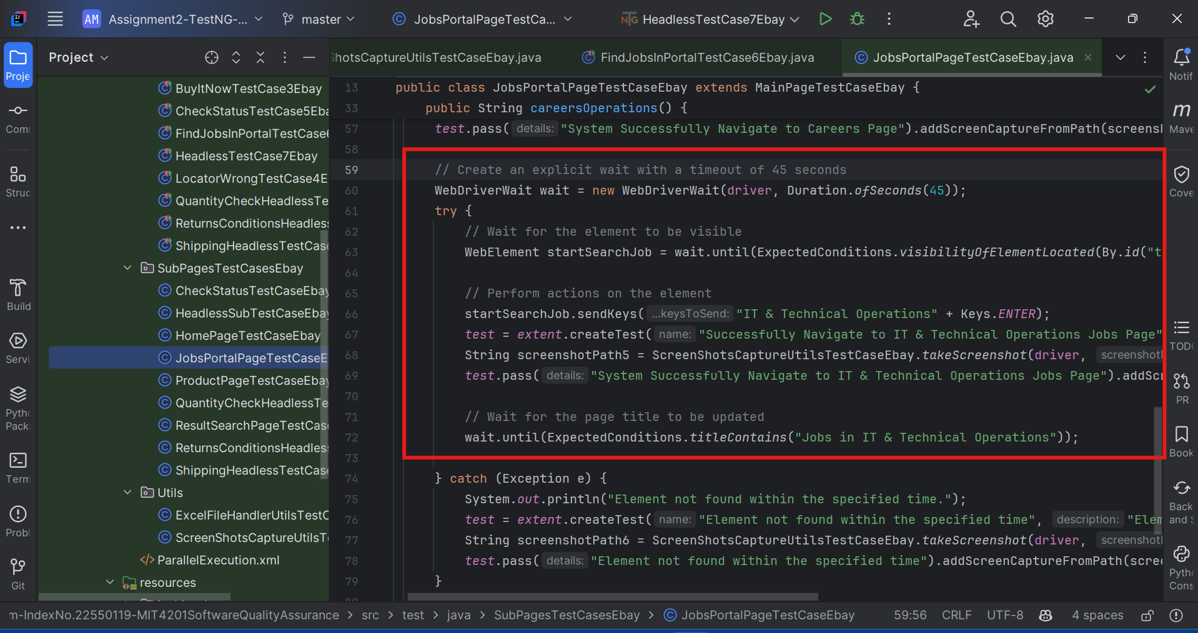
7. Utility Components - Wait Strategies Implementation

Slide 34
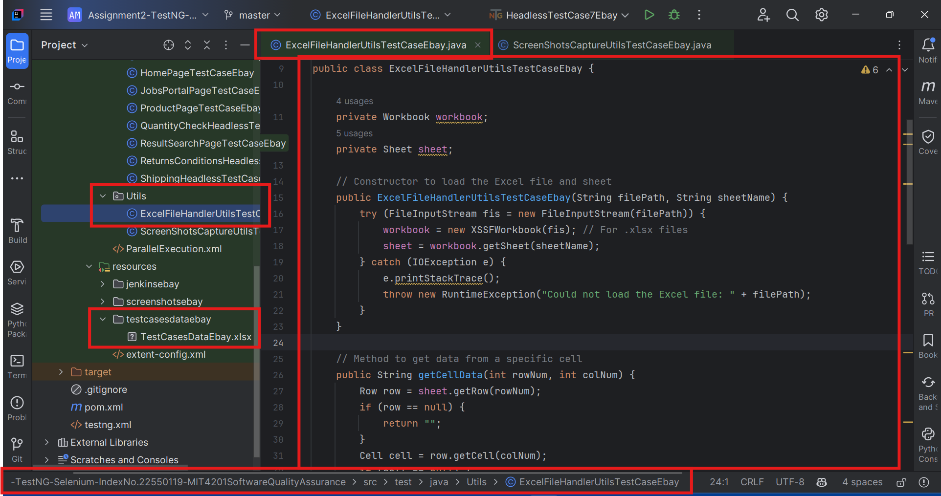
7. Utility Components - Excel File Handling Utilities

Slide 35
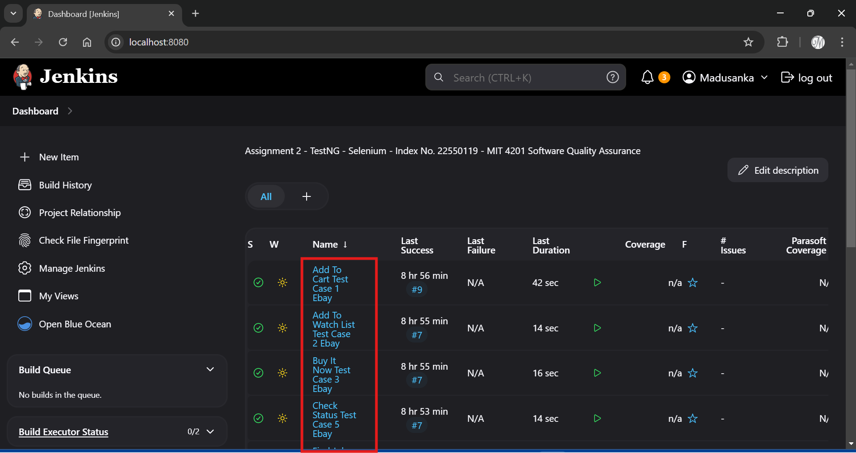
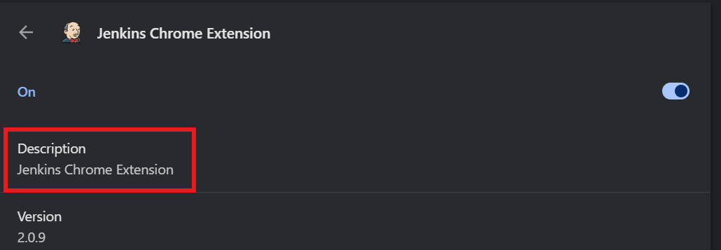
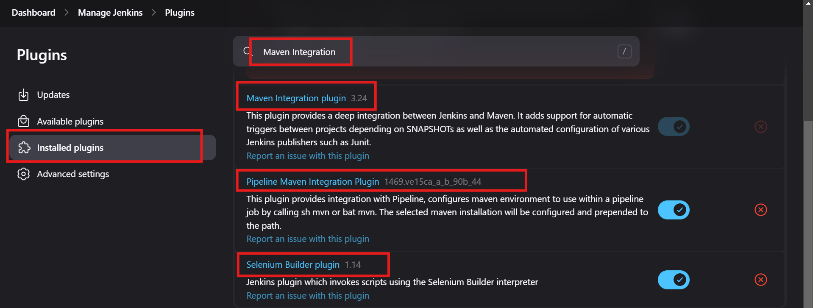
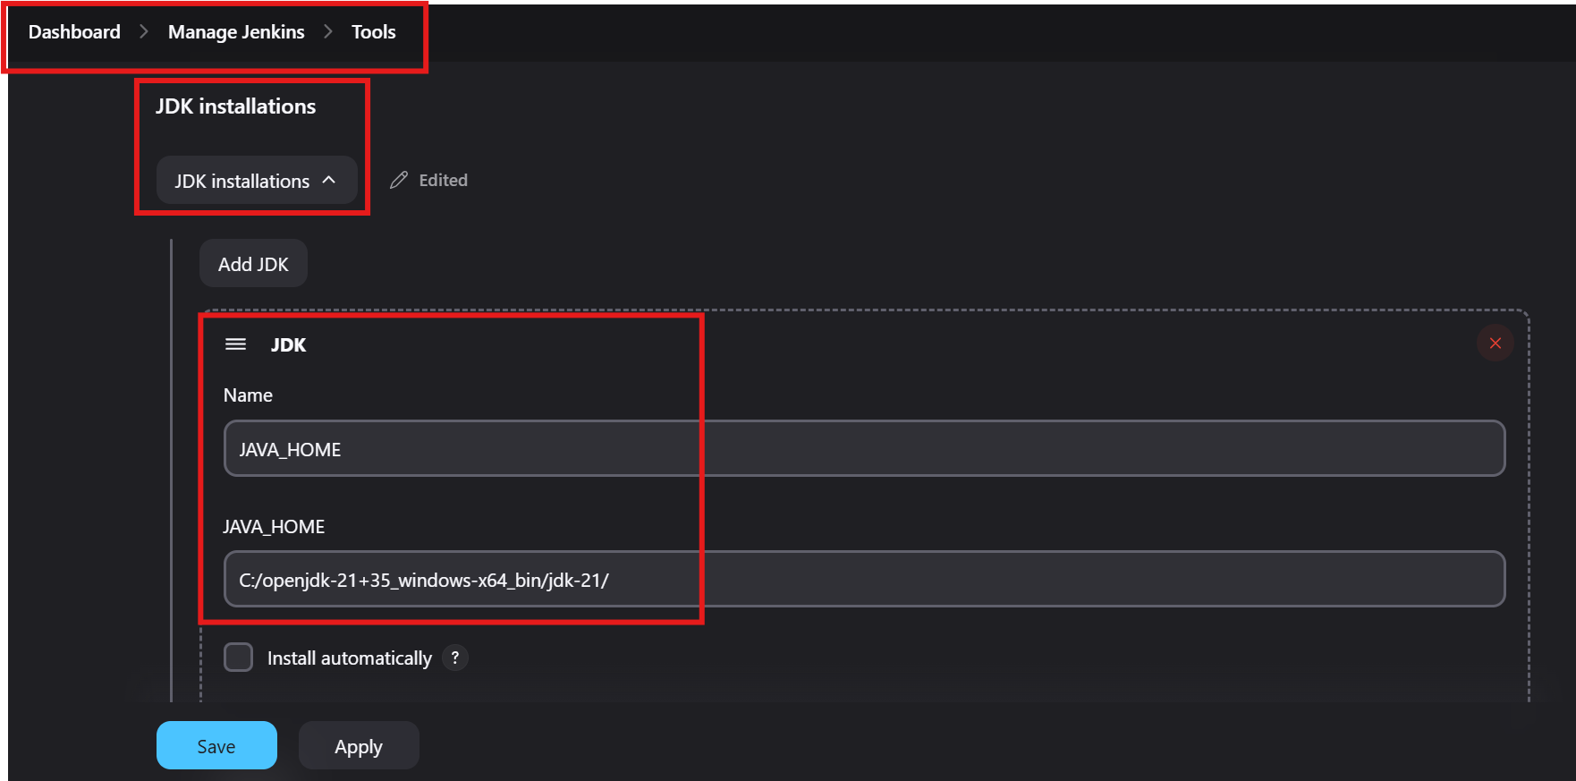
8. CI / CD Integration - Jenkins Pipeline Configuration

Slide 36
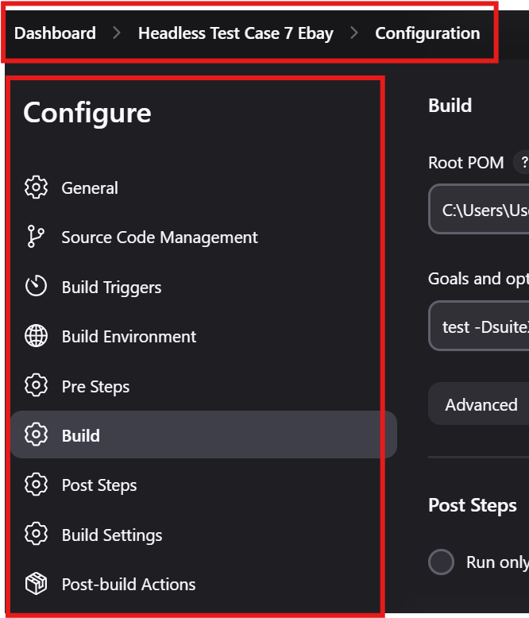
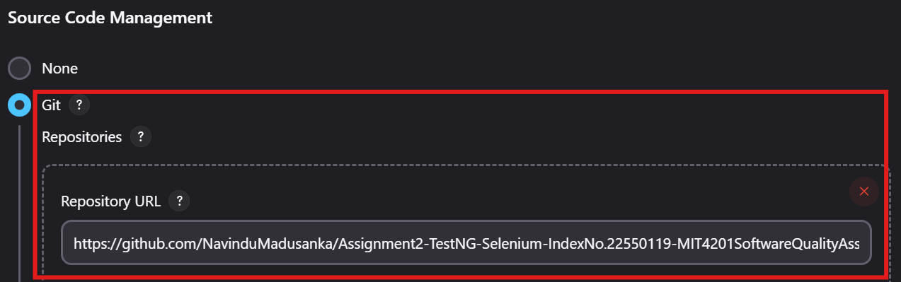
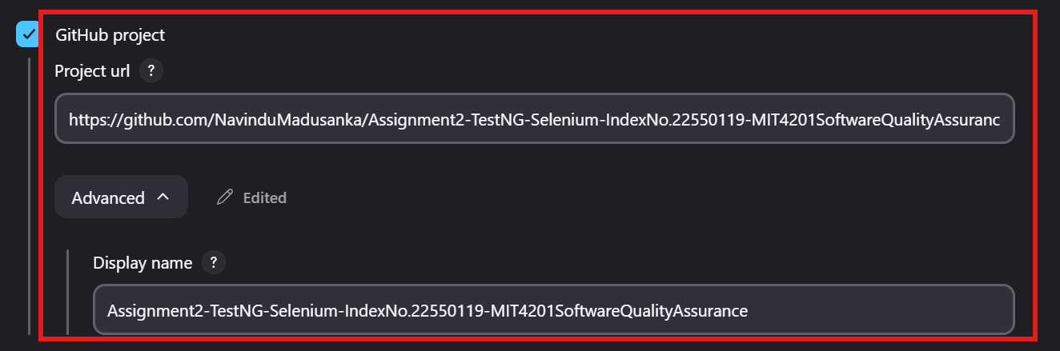
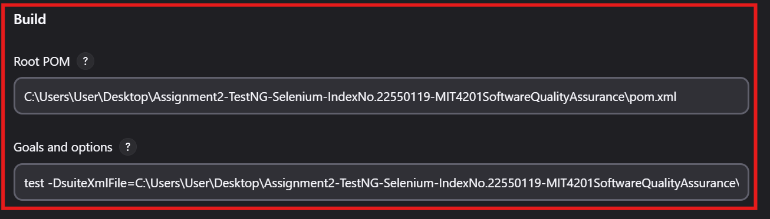
8. CI / CD Integration - Test Execution Scripts

Slide 37
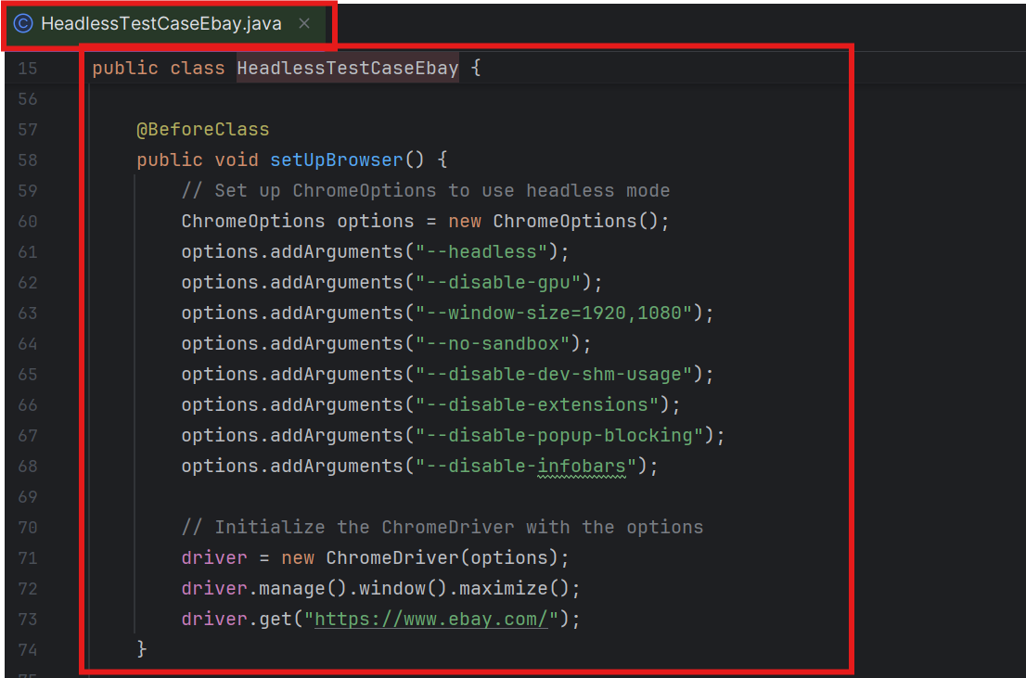
8. CI / CD Integration - Headless Browser Setup

Slide 38
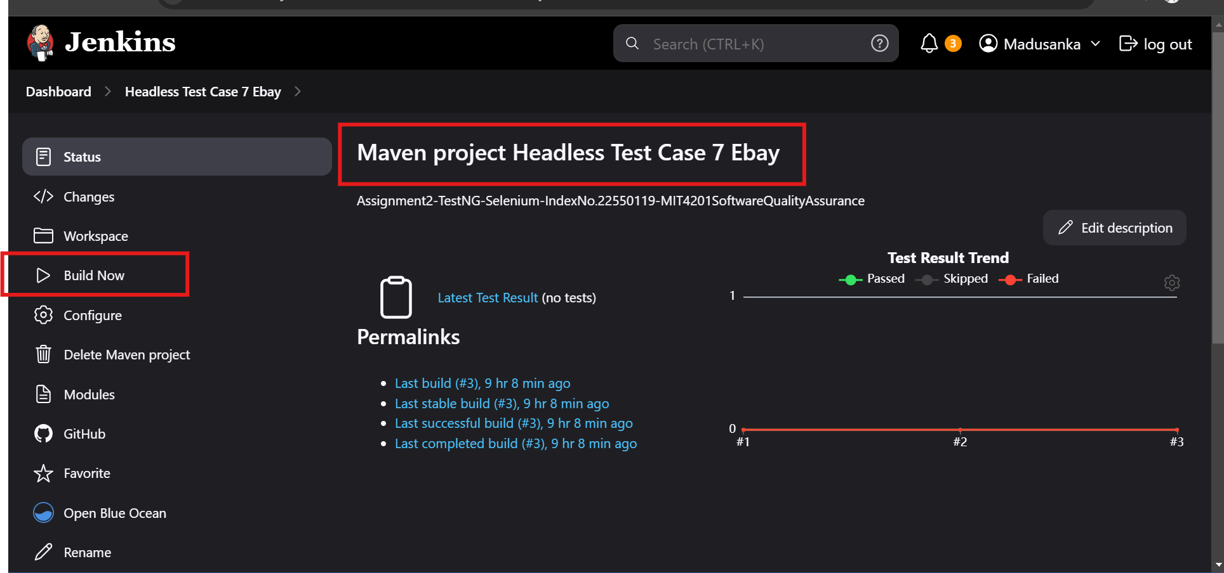
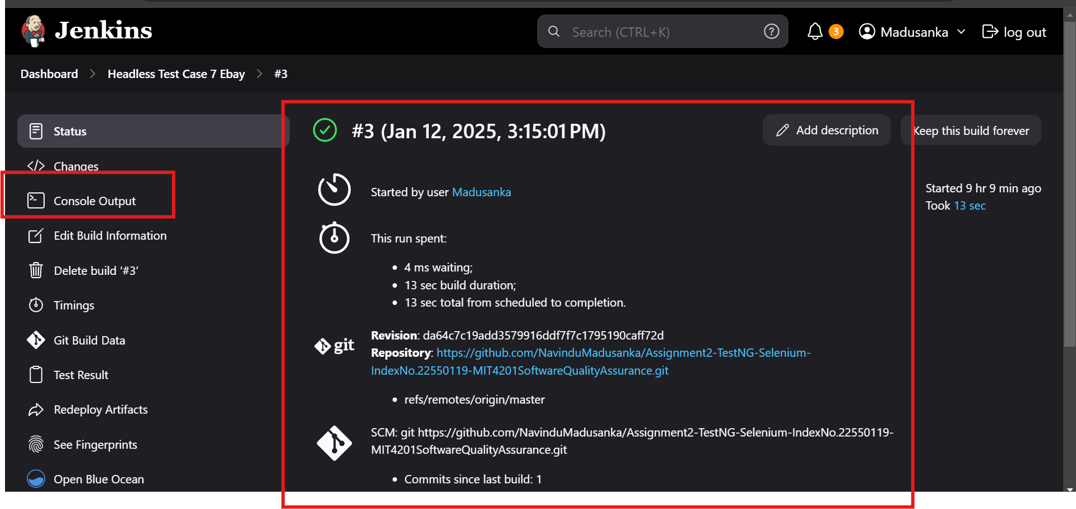
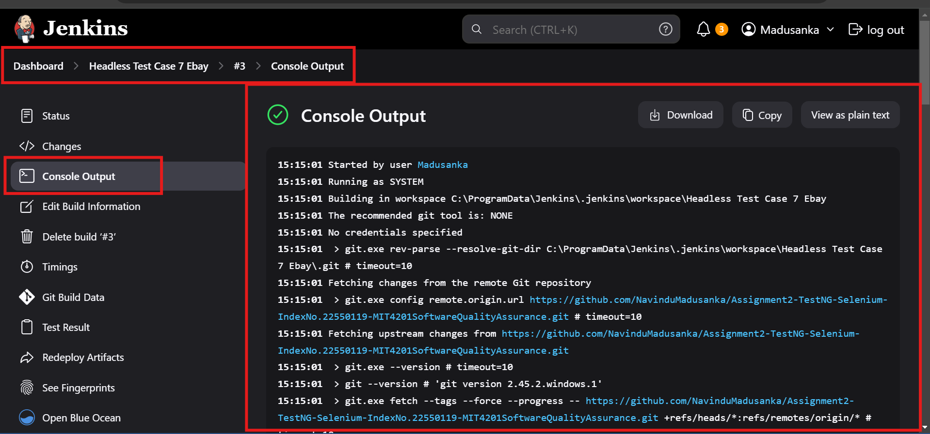
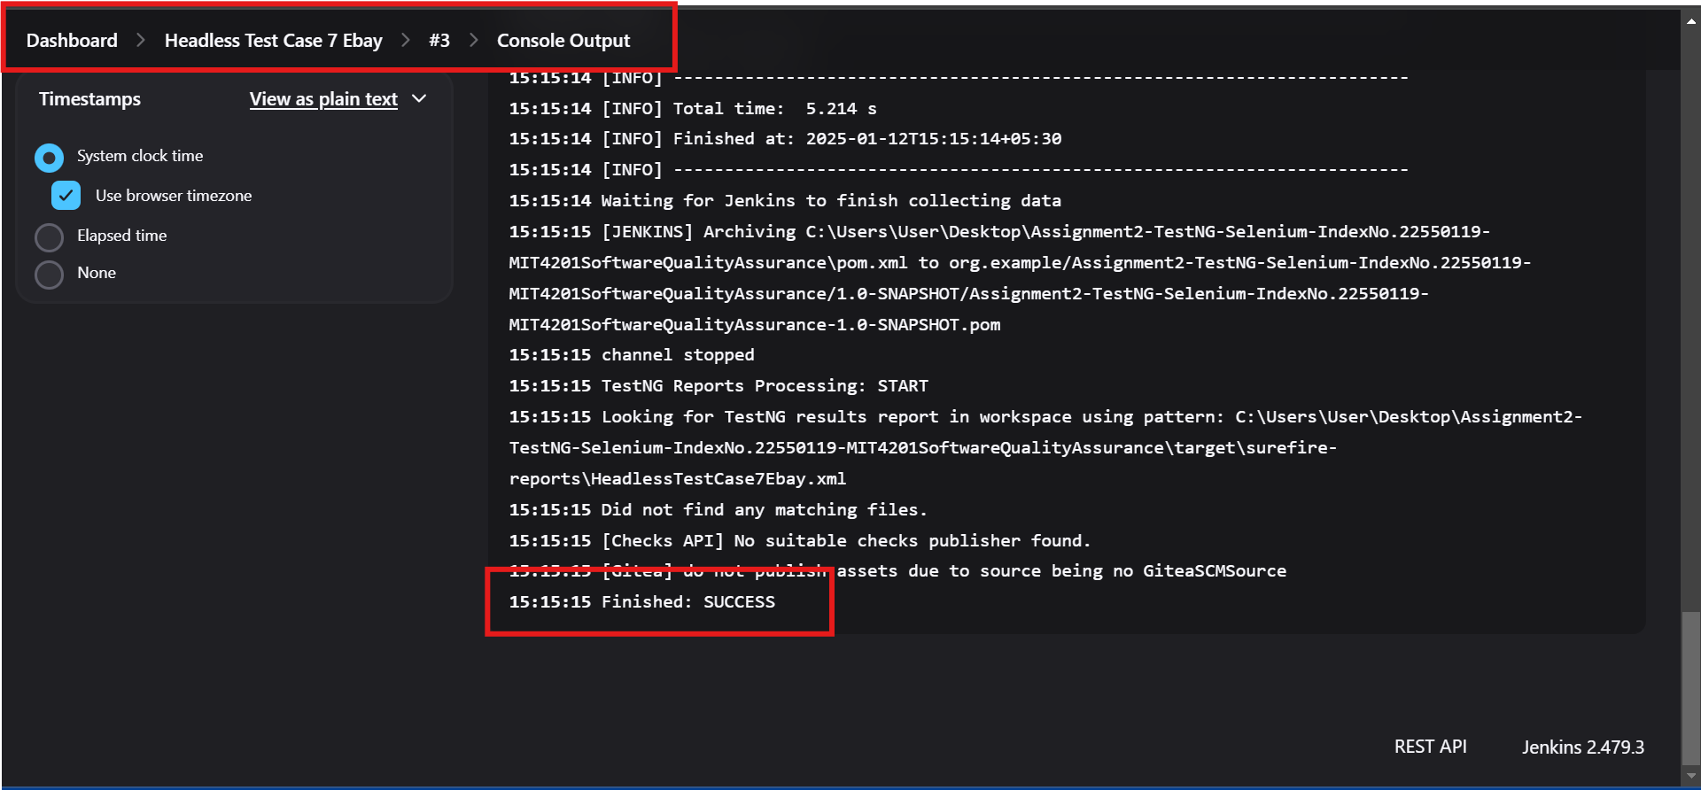
8. CI / CD Integration - Build and Deployment Scripts

Slide 39
Thank You

